Slide 1





Course Name object oriented analysis and design
CSC 2210
(Undergraduate)
Software engineering (Undergraduate)
Chapter 4 sequence diagram
M. Mahmudul hasan
Assistant Professor, CS, AIUB
http://www.dit.hua.gr/~m.hasan

Slide 2
Sequence diagram
MMH
S.2
Sequence Diagrams are interaction diagrams that detail how operations are carried out and models:
a single scenario executing in the system
communication behavior of individuals exchanging information to accomplish some task.
Sequence diagram—shows interacting individuals along the top and message exchange down the page.
Relation of UML diagrams to other exercises:
CRC cards -> Class diagram
Use cases -> Sequence diagrams

Slide 3
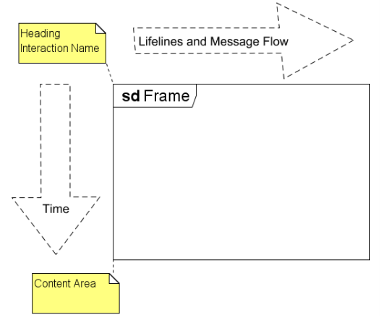
Key parts of sequence diagram
MMH
S.3
Frame: a rectangle with a pentagon in the upper left-hand corner called the name compartment.
sd - interaction Identifier is either a simple name or an operation specification as in a class diagram

Slide 4
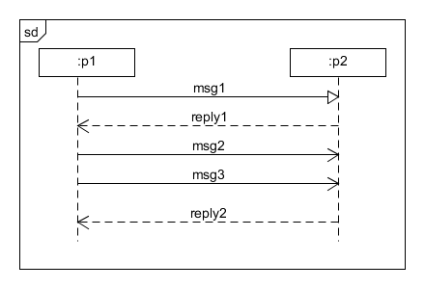
Key parts of Sequence diagram
MMH
S.4
Participant: an object or entity (actor, system) that acts in the sequence diagram (rectangle identifier)
Lifelines/Axes: Participating individuals are arrayed across the diagram as lifelines. The dashed line shows the period when an individual exists.
Horizontal: which object/participant is interacting
Vertical: time (down -> forward in time)
Message: communication between participant objects.

Slide 5
Messages and message arrows
MMH
S.5
Synchronous—The sender suspends execution until the message is complete (sender waits for reply)
Asynchronous—The sender continues execution after sending the message (no waiting time)
Synchronous Reply - Message return to the sender

Slide 6
Sequence diagram heuristics
MMH
S.6
Put the sender of the first message leftmost.
Put pairs of individuals that interact heavily next to one another.
Position individuals to make message arrows as short as possible.
Position individuals to make message arrows go from left to right.

Slide 7
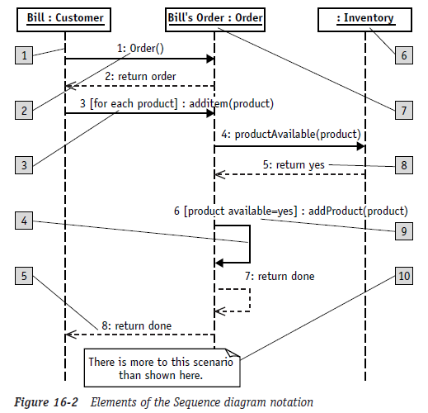
Sequence diagram elements
MMH
S.7
The reference numbers
on the figure denotes:
Object lifeline
Message/Stimulus
Iteration
Self-reference
Return
Anonymous object
Object name
Sequence number
Condition
Basic comment
Self Execution

Slide 8
Execution occurrence
MMH
S.8
An operation is executing when some process is running its code.
An operation is suspended when it sends a synchronous message and is waiting for it to return.
An operation is active when it is executing or suspended. The period when an object is active can be shown using an execution occurrence (Thin white or grey rectangle over lifeline dashed line)

Slide 9
references
MMH
S.9
Booch, G., Rumbaugh, J. & Jacobson, I. (2005). The unified modeling language user guide. Pearson Education India.

